Slide 1


Uganda Sickle Survey Results and Neonatal Screening Program
Charles Kiyaga
National Sickle Cell Coordinator
CPHL, Ministry of Health

Slide 2
Study Questions
What is the prevalence of sickle cell trait and disease in Uganda, by region and district?
What is the distribution of sickle cell trait across the country?
What is the relationship between sickle cell trait and malaria prevalence?
What is the early mortality of sickle cell disease?
What is the co-morbidity of HIV and sickle cell disease?

Slide 3
Sickle Cell Trait:
Prevalence by Region
Region | Normal | Variant | Trait | Trait (%) | Disease | Disease (%) | TOTAL
Central 1 | 12187 | 30 | 1802 | 12.80 | 64 | 0.45 | 14083
Central 2 | 9048 | 31 | 1486 | 13.95 | 85 | 0.80 | 10650
East Central | 4911 | 42 | 1201 | 19.24 | 89 | 1.43 | 6243
Kampala | 11006 | 40 | 1725 | 13.42 | 81 | 0.63 | 12852
Mid Eastern | 3835 | 35 | 721 | 15.52 | 55 | 1.18 | 4646
Mid Northern | 9681 | 121 | 2359 | 19.16 | 153 | 1.24 | 12314
Mid Western | 10897 | 31 | 1358 | 11.00 | 59 | 0.48 | 12345
North East | 3517 | 30 | 651 | 15.36 | 40 | 0.94 | 4238
South Western | 12440 | 16 | 586 | 4.48 | 25 | 0.19 | 13067
West Nile | 2421 | 50 | 394 | 13.69 | 13 | 0.45 | 2878
Total | 79943 | 426 | 12283 | 13.16 | 664 | 0.71 | 93316

Slide 4
Study Questions
What is the prevalence of sickle cell trait and disease in Uganda, by region and district?
What is the distribution of sickle cell trait across the country?
What is the relationship between sickle cell trait and malaria prevalence?
What is the early mortality of sickle cell disease?
What is the co-morbidity of HIV and sickle cell disease?

Slide 5
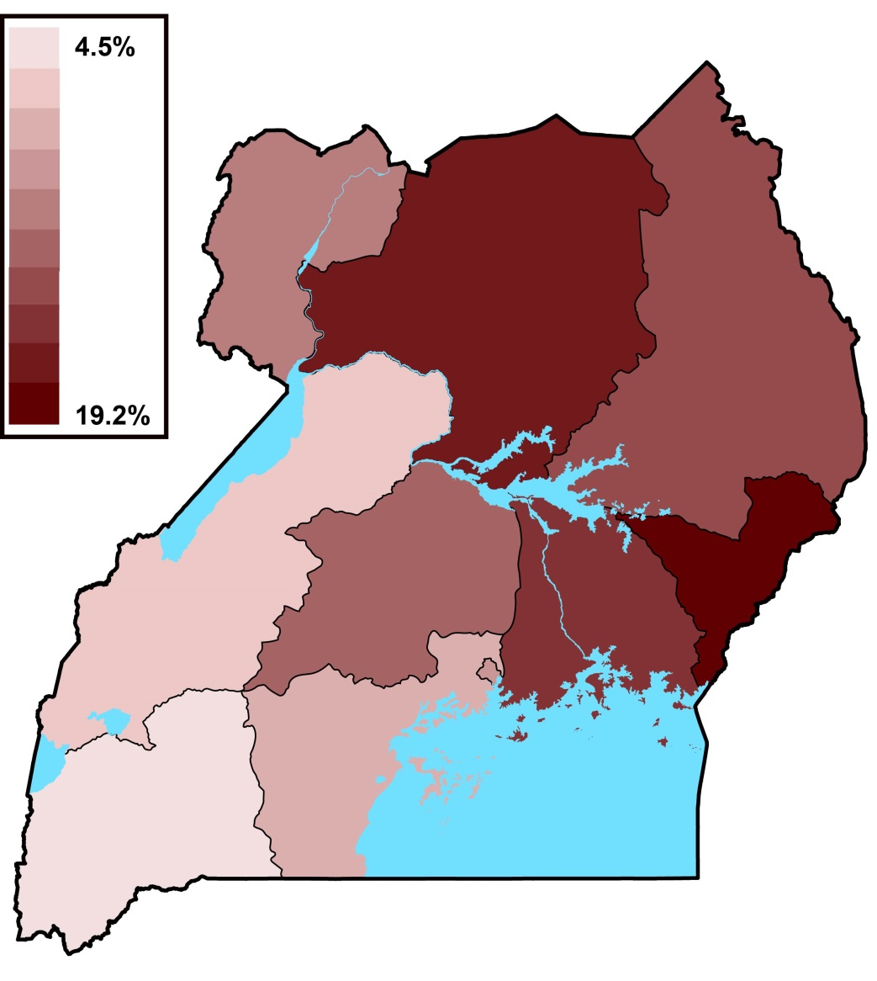
Uganda Regional Map (US3 Data)
Sickle Cell Trait
Mid Northern
MP 63%
North East
MP 40%
Sickle Cell
Trait 13.7%
Sickle Cell
Trait 19.2%

Slide 6
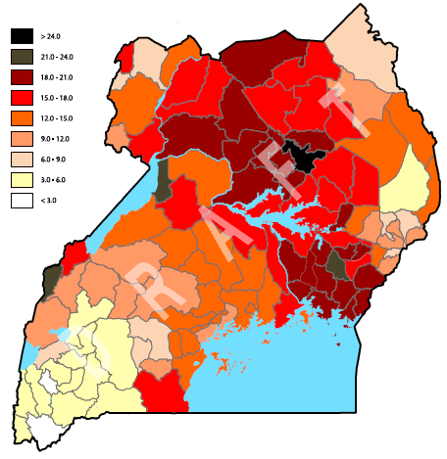
Uganda District Map (US3 Data)
Sickle Cell Trait
Mid Northern
MP 63%
North East
MP 40%
Sickle Cell
Trait 13.7%
Sickle Cell
Trait 19.2%

Slide 7
Highest Prevalence Districts
49 of the 112 districts have sickle cell trait >15.0%
8 districts have sickle cell trait >20.0%
Bundibugyo 21.9%, Bulisa 22.1%, Alebtong 24.3%
Jinja 18.9%, Tororo 19.5%, Gulu 19.6%, Lira 20.0%
14 districts contain 47% of the sickle cell disease
Kampala, Gulu, Lira, Jinja, Tororo, Luweero, Wakiso
Apac, Iganga, Muyuge, Buikwe, Oyam, Masaka, Masindi
Screening should focus on highest burden regions

Slide 8
Study Questions
What is the prevalence of sickle cell trait and disease in Uganda, by region and district?
What is the distribution of sickle cell trait across the country?
What is the relationship between sickle cell trait and malaria prevalence?
What is the early mortality of sickle cell disease?
What is the co-morbidity of HIV and sickle cell disease?

Slide 9
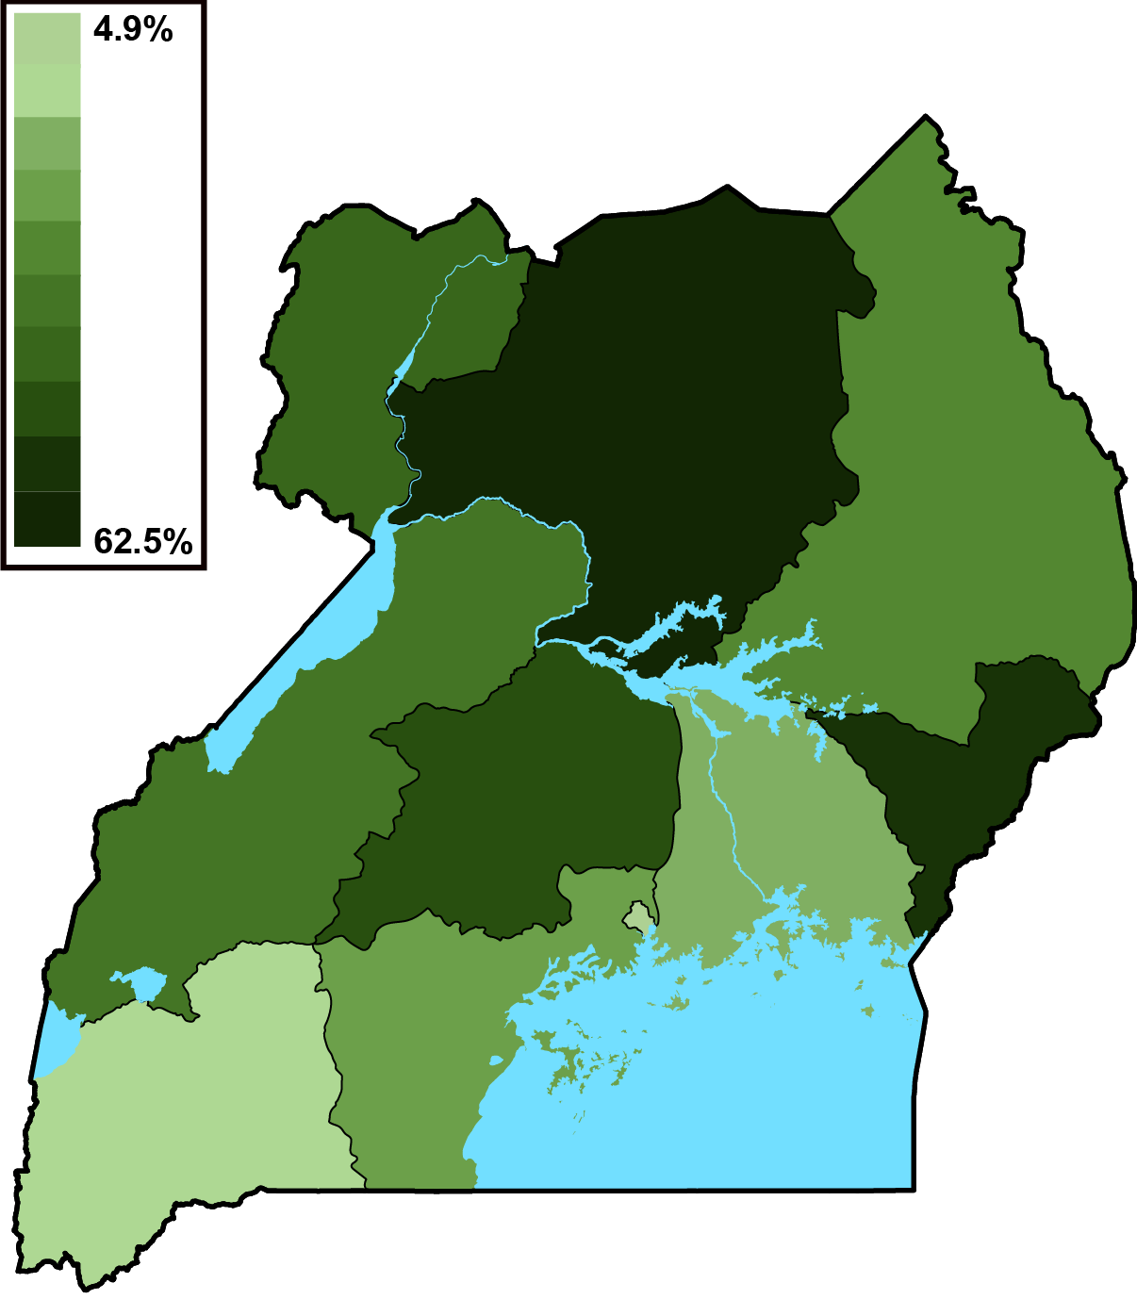
Uganda Regional Maps (US3 Data)
Sickle Cell Trait and Malaria
Mid Northern
MP 63%
North East
MP 40%
Sickle Cell
Trait 13.7%
Sickle Cell
Trait 19.2%

Slide 10
Malaria Parasites and Sickle Cell Trait
R = 0.69
Sickle Cell Trait (%)
Malaria Parasites (% with + microscopy)

Slide 11
Study Questions
What is the prevalence of sickle cell trait and disease in Uganda, by region and district?
What is the distribution of sickle cell trait across the country?
What is the relationship between sickle cell trait and malaria prevalence?
What is the early mortality of sickle cell disease?
What is the co-morbidity of HIV and sickle cell disease?

Slide 12
Sickle Cell Disease: Early Mortality
EID samples are between birth and 18 months of age
Analysis of sickle cell trait and disease by age
Predictions:
Rate of sickle cell trait will increase (malaria survival)
Rate of sickle cell disease will decrease (mortality)
25% Mortality
 | Normal (%) | Trait (%) | Disease (%)
Birth – 6.0 months | 85.63 | 13.09 | 0.76
6.1 – 12.0 months | 85.78 | 13.27 | 0.64
12.1 – 18.0 months | 85.73 | 13.36 | 0.57

Slide 13
Study Questions
What is the prevalence of sickle cell trait and disease in Uganda, by region and district?
What is the distribution of sickle cell trait across the country?
What is the relationship between sickle cell trait and malaria prevalence?
What is the early mortality of sickle cell disease?
What is the co-morbidity of HIV and sickle cell disease?

Slide 14
Sickle Cell Disease and HIV
All EID samples are from HIV-exposed infants
~5% of the EID samples are HIV-positive
Prediction:
In (+) HIV infants, sickle cell disease is associated with early death
41% Mortality
 | Normal | Trait | Disease
HIV Negative Infants | 86.1% | 13.2% | 0.73%
HIV Positive Infants | 86.6% | 13.0% | 0.43%

Slide 15
Opportunities to Neonatal Sickle Cell Screening
Results of the sickle cell prevalence study
Laboratory capacity built through the study
Sample and results transport network

Slide 16
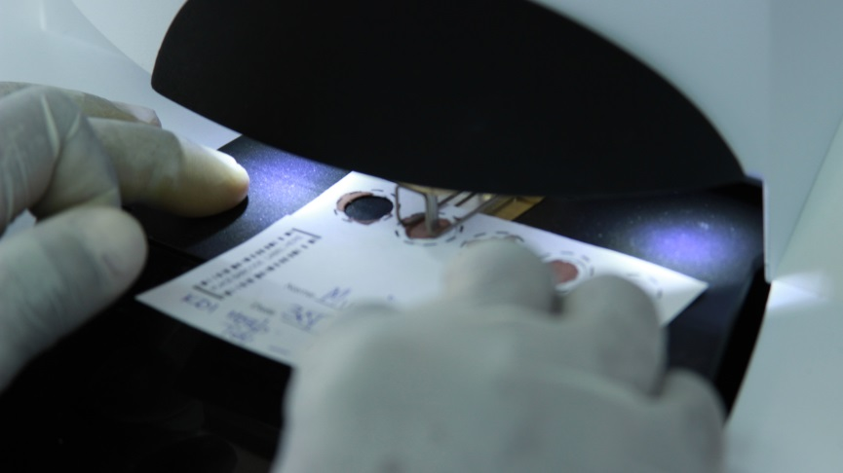
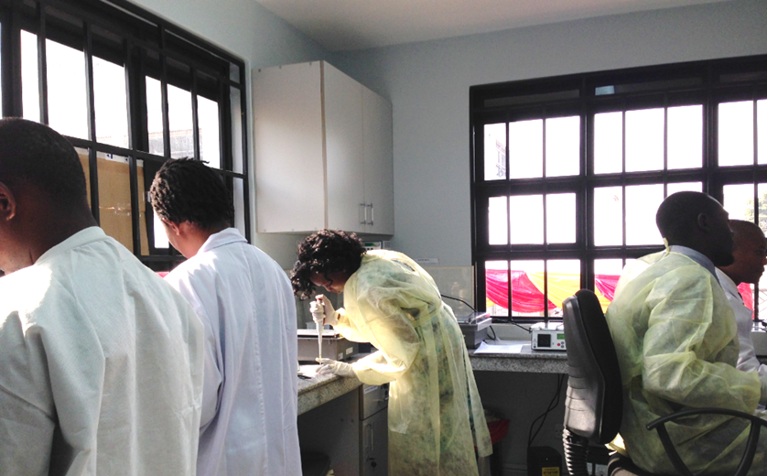
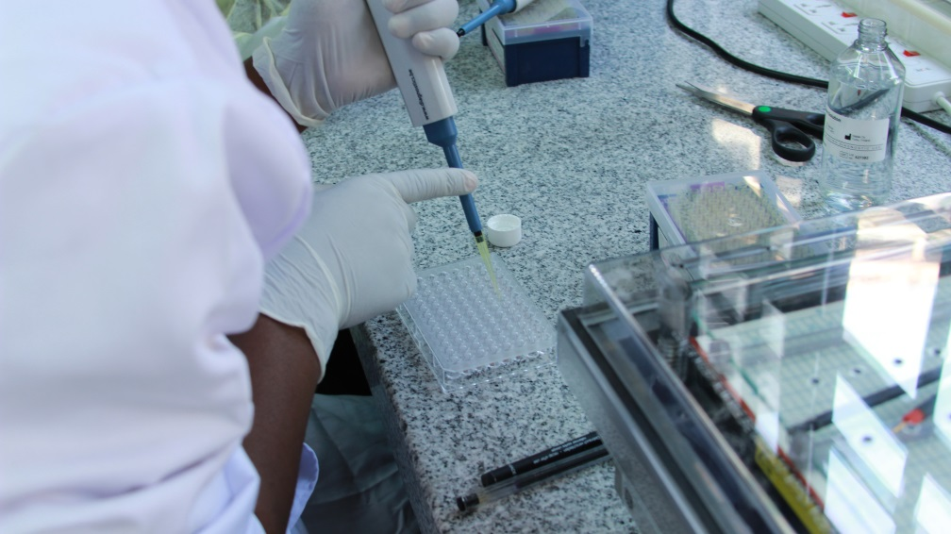
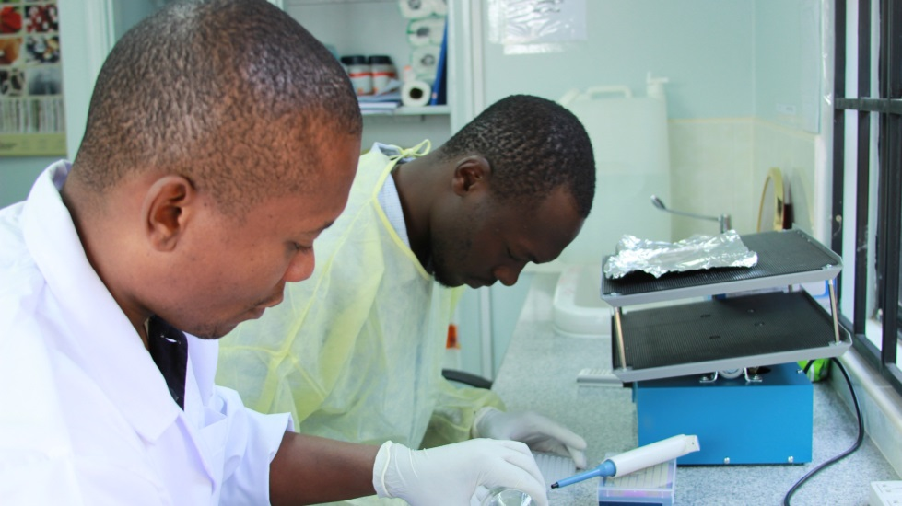
Early Diagnosis
CPHL Sickle Cell Laboratory with Annual Testing Capacity of >600,000 tests

Slide 17
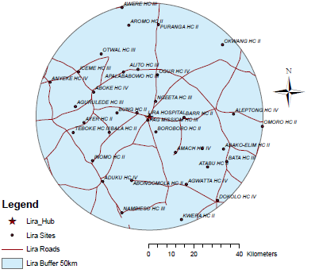
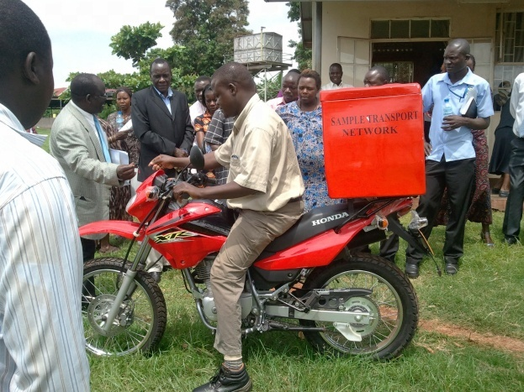
The Hub-based National Specimens and Result Transportation Network
Structure of the hub network
Map showing current Hub Distribution
The bike and rider given to each hub/district, Holly Foundation clinic
82 hubs reaching 2400 health facilities with viable laboratories conducting most of the tests for the 30 or so lower facilities in its catchment
Strategy is to have 100 hubs and strengthen lab services such that lower sites access them thru the NSRTN

Slide 18
 | Progress to date
District | No. of sites | No. tested
Gulu | 42 | 2158
Lira | 31 | 1781
Kitgum | 19 | 963
Oyam | 33 | 1451
Dokolo | 16 | 67
Jinja | 28 | 1936
Tororo | 41 | 2031
Makerere launch |  | 1803
Eden Church |  | 237
Namasuba College |  | 103
Total | 211 | 12,530

Slide 19
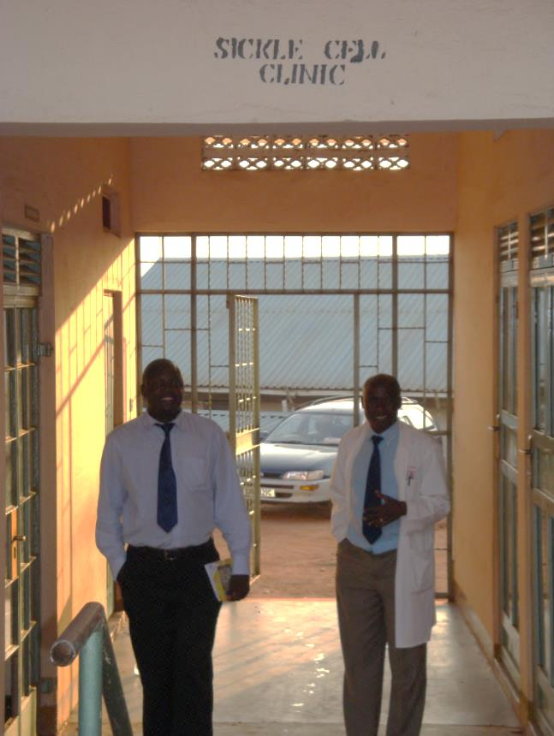
Care and Treatment
Early care and treatment
Penicillin prophylaxis
Malaria control and prophylaxis
PCV (pneumococcal) and other immunizations
Clinical management
Health education
Screening for stroke risk
Home management
Enroll the baby into sickle cell care
Dedicated sickle cell clinic days and staff
Establish routine follow-up
Establish emergency SCD care plan
Continued family education

Slide 20
Acknowledgements
Cincinnati Children’s Hospital in the USA
Dedication and support of the CPHL leadership and laboratory staff
Makerere University for support of research and educational efforts
MoH for vision and planning to allow this project to move forward

